Slide 1




Year 3 - Spring - Block 5
Fractions

Slide 2
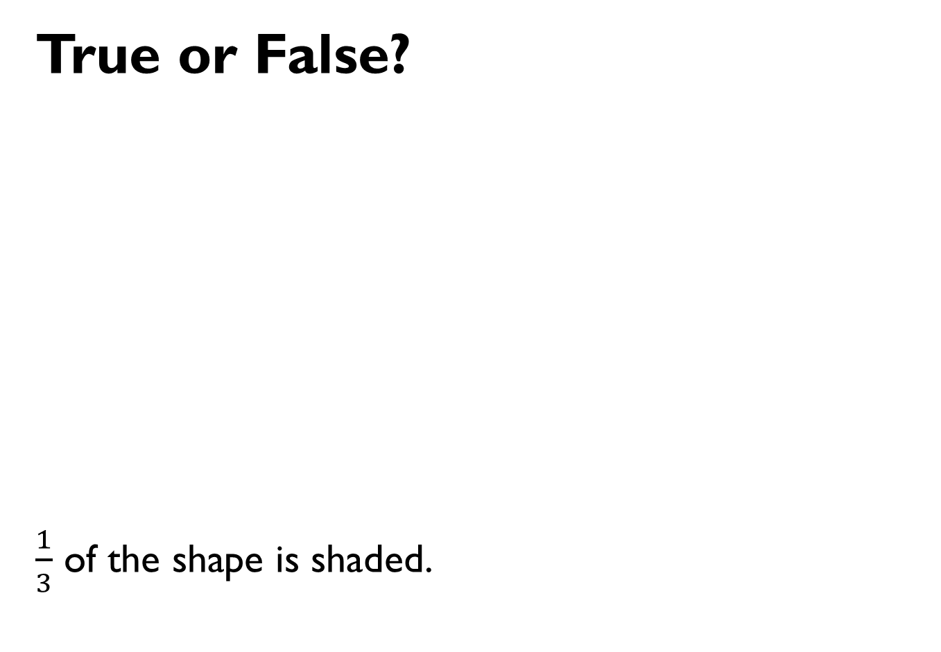
True or False?
$\frac{1}{3}$ of the shape is shaded.

Slide 3









Sort the fractions into the table.
Are there any boxes in the table empty?
Why?
 | Fractions equal to one whole | Fractions less than one whole
Unit fractions
Non-unit fractions
$$\frac{3}{4}$$
$$\frac{1}{2}$$
$$\frac{3}{5}$$
$$\frac{1}{3}$$
$$\frac{1}{4}$$
$$\frac{2}{2}$$
$$\frac{4}{4}$$
$$\frac{2}{5}$$

Slide 4

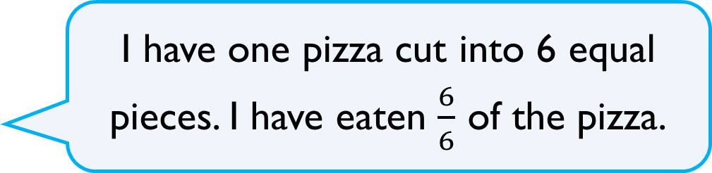
Teddy says,
Does Teddy have any pizza left?
Explain your answer.
I have one pizza cut into 6 equal pieces. I have eaten $\frac{6}{6}$ of the pizza.

Slide 5
Complete the sentence.
When a fraction is equal to a whole, the numerator and the denominator are
______________________ .
Use pictures to prove your answer.

Slide 6



Rosie is drawing bar models to represent a whole.
She has drawn a fraction of each of her bars.
Can you complete Rosie’s bar models?
$$\frac{1}{2}$$
$$\frac{1}{4}$$
$$\frac{1}{3}$$

Slide 7
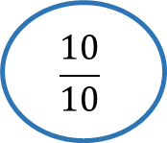
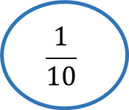
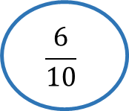
Fill in the missing values.
Explain how you got your answers.
$$\frac{10}{10}$$
$$\frac{6}{10}$$
$$\frac{1}{10}$$

Slide 8


Odd One Out
Which is the odd one out?
Explain your answer.

Slide 9
Teddy is counting in tenths.
Can you spot his mistake?
Seven tenths, eight tenths, nine tenths, ten tenths, one eleventh, two elevenths, three elevenths…

Slide 10
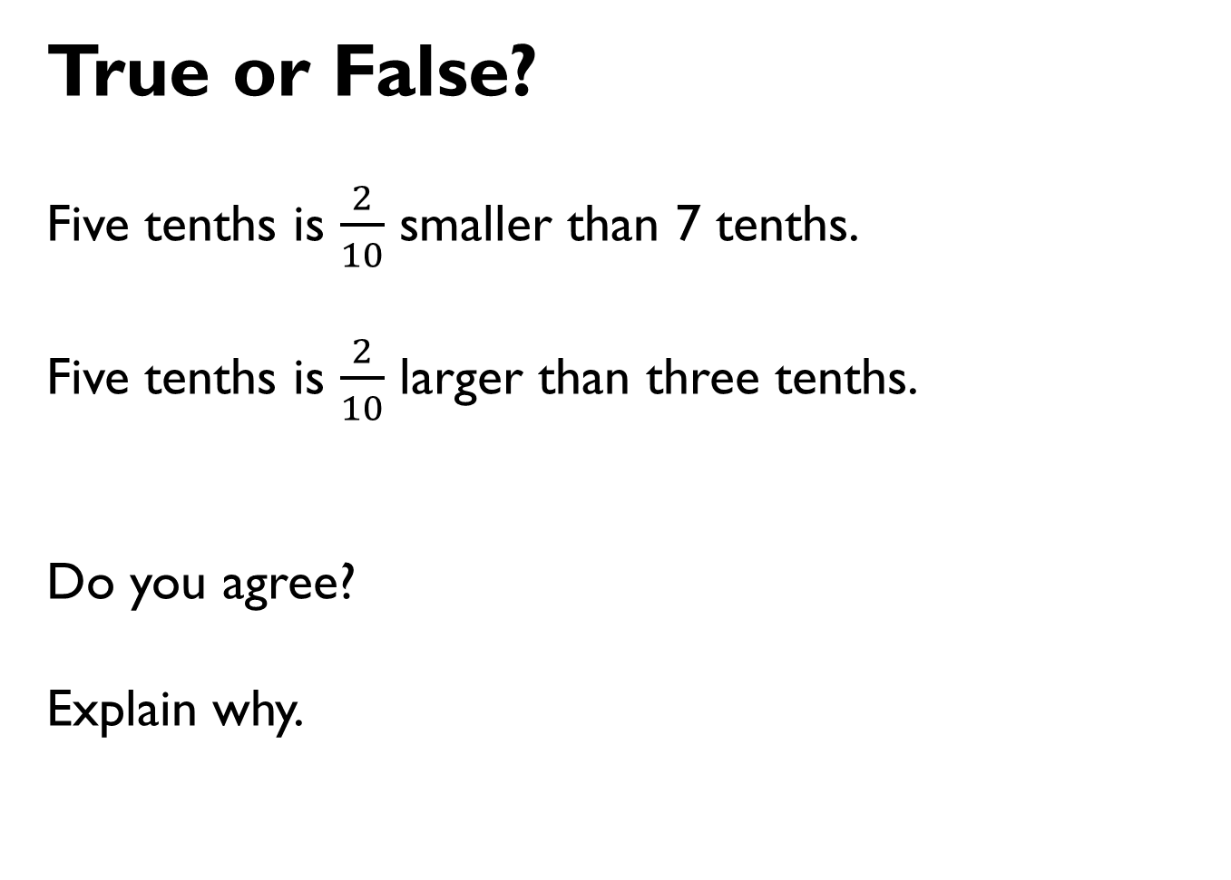
True or False?
Five tenths is $\frac{2}{10}$ smaller than 7 tenths.
Five tenths is $\frac{2}{10}$ larger than three tenths.
Do you agree?
Explain why.

Slide 11


True or False?
Dora
Amir
Explain your answer.
10 cm is one tenth of 1 metre
10 cm is 0.1 metres.

Slide 12
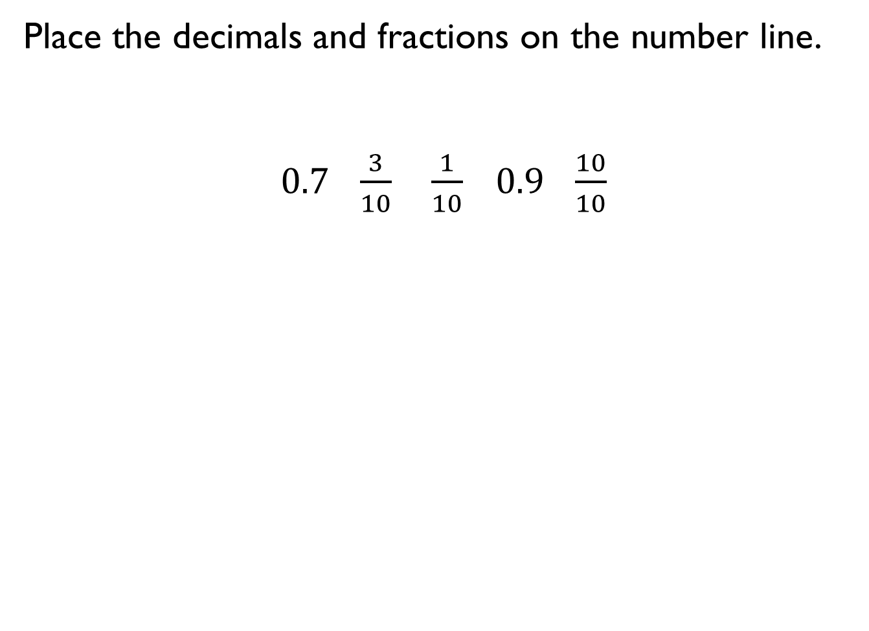
Place the decimals and fractions on the number line.
$0.7 \frac{3}{10} \frac{1}{10} 0.9 \frac{10}{10}$
0
1

Slide 13






Eva has drawn a number line.
Tommy says it is incorrect.
Do you agree with Tommy?
Explain why.
Can you draw the next three fractions?
1
$\frac{1}{4}$
$\frac{2}{4}$
$\frac{3}{4}$
$\frac{1}{4}$
$\frac{2}{4}$
$\frac{3}{4}$
2
1
1
1

Slide 14
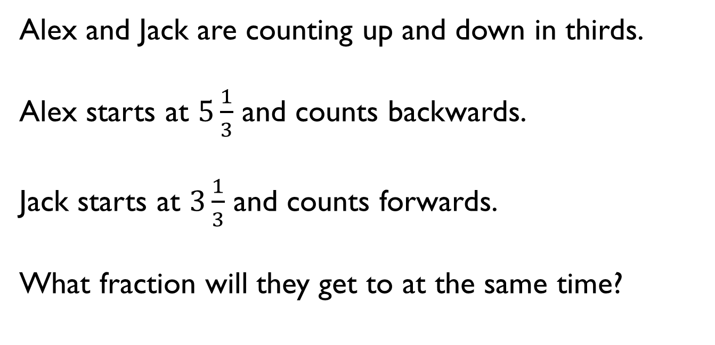
Alex and Jack are counting up and down in thirds.
Alex starts at $5\frac{1}{3}$ and counts backwards.
Jack starts at $3\frac{1}{3}$ and counts forwards.
What fraction will they get to at the same time?

Slide 15

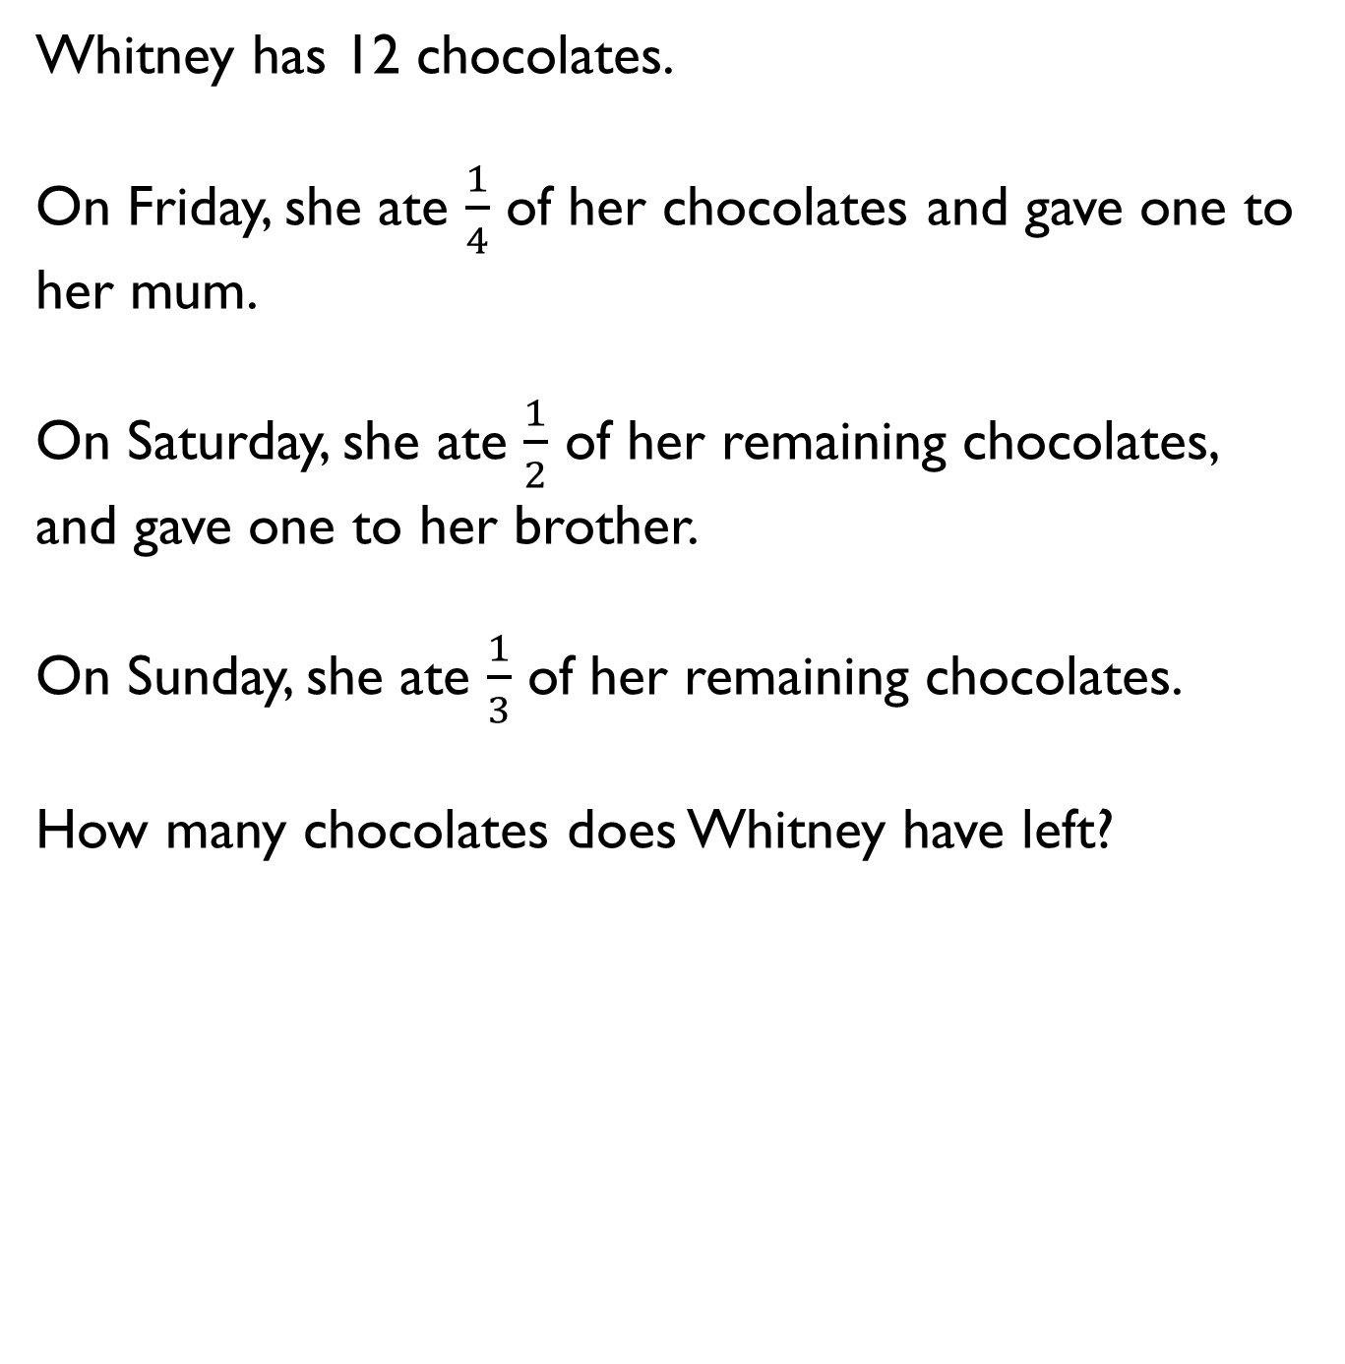
Whitney has 12 chocolates.
On Friday, she ate $\frac{1}{4}$ of her chocolates and gave one to her mum.
On Saturday, she ate $\frac{1}{2}$ of her remaining chocolates, and gave one to her brother.
On Sunday, she ate $\frac{1}{3}$ of her remaining chocolates.
How many chocolates does Whitney have left?

Slide 16
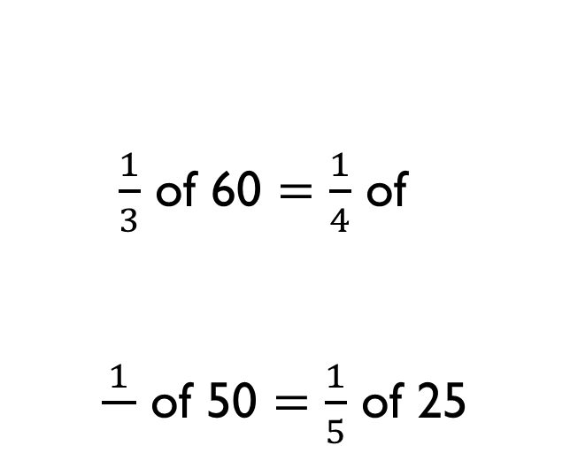
Fill in the Blanks
$\frac{1}{3}$ of 60 $=$ $\frac{1}{4}$ of
$\frac{1}{}$ of 50 $=\frac{1}{5}$ of 25

Slide 17

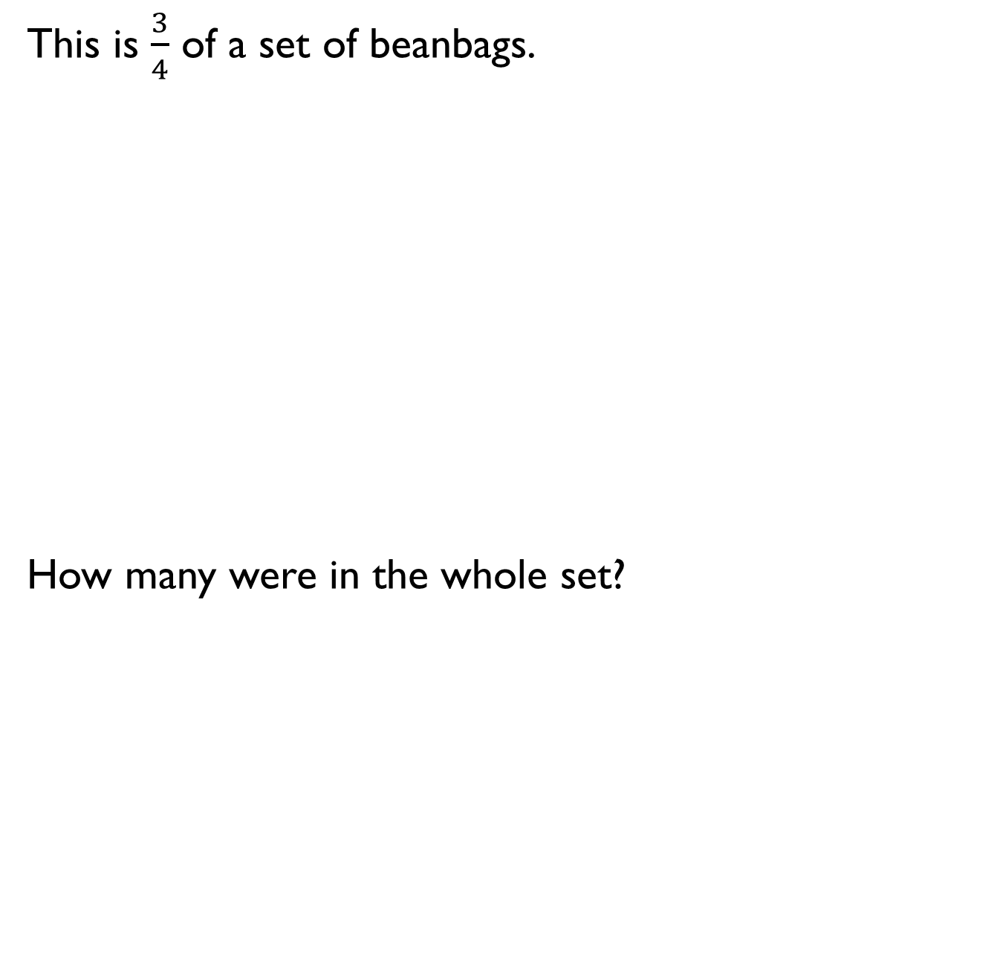
This is $\frac{3}{4}$ of a set of beanbags.
How many were in the whole set?

Slide 18
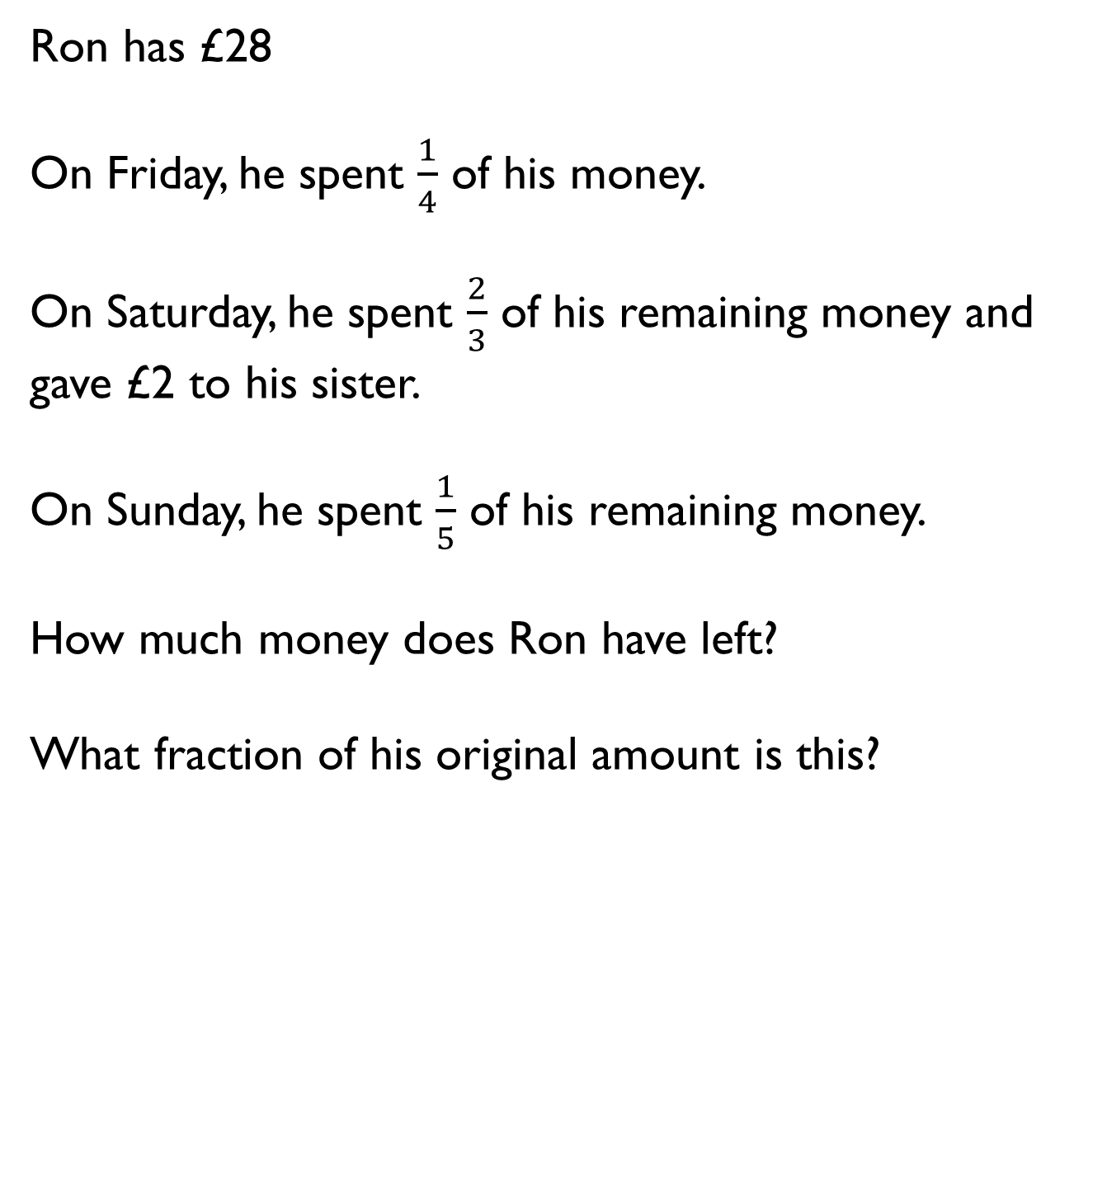
Ron has £28
On Friday, he spent $\frac{1}{4}$ of his money.
On Saturday, he spent $\frac{2}{3}$ of his remaining money and gave £2 to his sister.
On Sunday, he spent $\frac{1}{5}$ of his remaining money.
How much money does Ron have left?
What fraction of his original amount is this?

Slide 19

Mo makes 3 rugby shirts.
Each rugby shirt uses 150 cm of material.
He has a 600 cm roll of material.
How much material is left after making the 3 shirts?
What fraction of the original roll is left over?

Slide 20

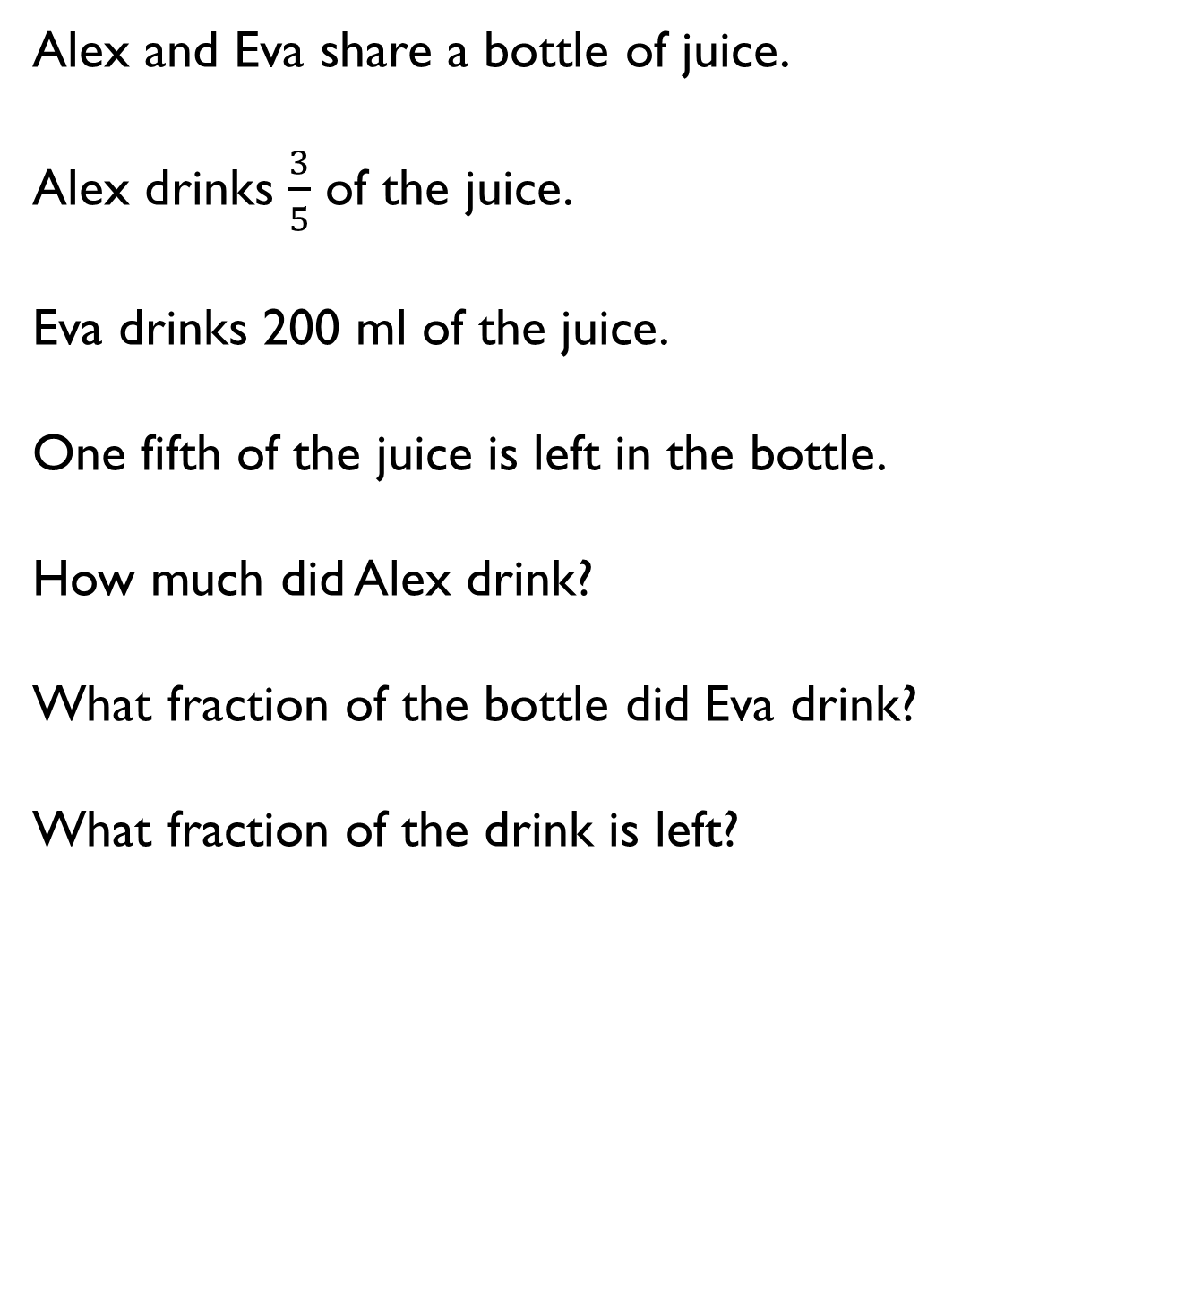
Alex and Eva share a bottle of juice.
Alex drinks $\frac{3}{5}$ of the juice.
Eva drinks 200 ml of the juice.
One fifth of the juice is left in the bottle.
How much did Alex drink?
What fraction of the bottle did Eva drink?
What fraction of the drink is left?

